Slide 1


CANoe uCut & Cranking tests; Climatic chamber
More Lives Saved
More Life Lived
Agapi Grigore
SWV

Slide 2
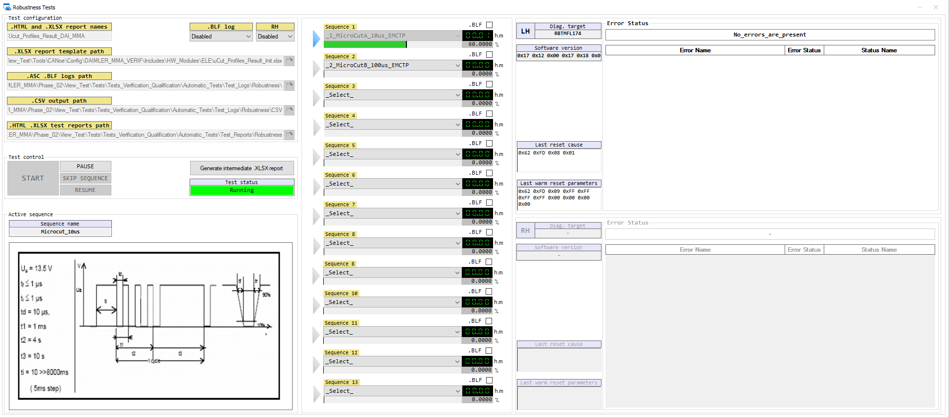

Slide 3
Needed files:
1. Electrical_Tests.can → Contains all tests, functions and panel controls
2. ElectricalTestsConfig.sysvar → System variables
3. Robustness Tests.xvp → Panel interface
4. CSVtoXLSX.exe → Generates .xlsx reports based on .csv reports generated by CANoe
PTC location: e:/MKSProjects/SWVR_PP_CI_Activities/CANOE_TEST_PLATFORM/Includes/HW_Modules/ELE/
Implemented and tested on : CANoe Build 15.4.35 (SP4) – 64 bit
Prerequisites:
e:/MKSProjects/SWVR_PP_CI_Activities/CANOE_TEST_PLATFORM/Includes/HW_Modules/SIG & TMP are added to the config.
- CANoe testing CORE structure is needed for this implementation → Core_Functions_Configuration.cin must be set up.

Slide 4
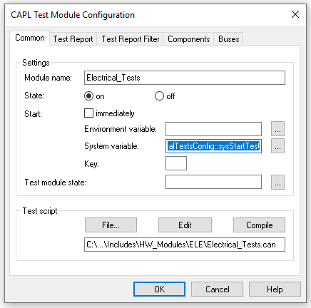
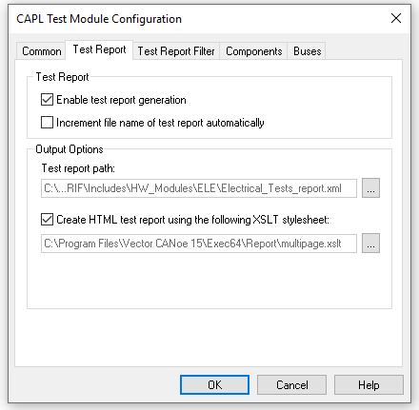
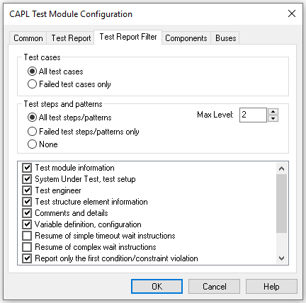
1. Electrical_Tests.can
- Create a CAPL test module set to trigger on “ElectricalTestsConfig::sysStartTest” and using “Electrical_Tests.can”. Configure as seen below.
2. ElectricalTestsConfig.vsysvar
Import to CANoe configuration: Environment → System Variables → Select File → Open
3. Robustness Tests.xvp
Import to CANoe configuration: Home → Panel → Add Panel…
4. CSVtoXLSX.exe
Add to CANoe configuration: File → Options → Extensions → User Files→ Add

Slide 5
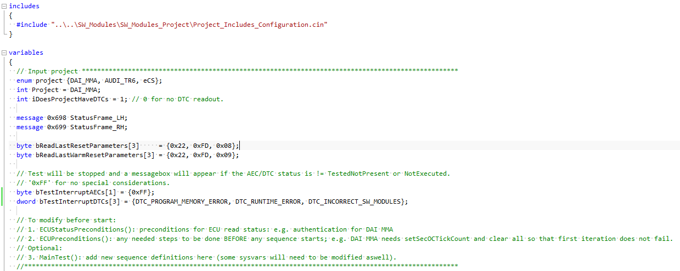
Other info:
To configure your project, the items pictured below must be modified (variable section of Electrical_Tests.can).
Only open the intermediate reports during test run (generated with “Generate intermediate .XLSX report” button).

Slide 6

Saving More Lives

